Slide 1
Welcome

Slide 2
V (t)
V (t)
V (t)
Determining Time constant of a RC circuit
V (t)
V (t)
V (t)

Slide 3
Topic
Determining Time constant of a RC circuit
Submitted to
DR. KAMRUN NAHAR MUKTA
Assistant Professor
Dept. of FST AIUB
Presented by group: 4
S.M.Walid 23-50005-1
Kawser Khan 23-50192-1
Abir Tirtha Das 23-50228-1
Farhan Shahriar Joy 23-50306-1
Abu Bakkar Siddik 23-50049-1

Slide 4
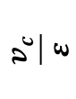
Theory
Capacitors are an electrical component which stores energy as electrostatic force.
RC circuit contains a resistor and a capacitor in series format.
The product RC is called the time constant.
Time constant is written in Greek latter τ, and unit is second.
For charging τ time for V(t) to reach 63% is its final value.
For discharging τ time for V(t) to fall 63% is its first value.
100
8 divisions
A
+
63
5 divisions
-
R
$$\frac{v_{c}}{ε}$$
B
3 divisions
C
37
V (t)
Figure: RC Circuit
τ
τ
Time
Figure: Potential difference vs Time constant.

Slide 5
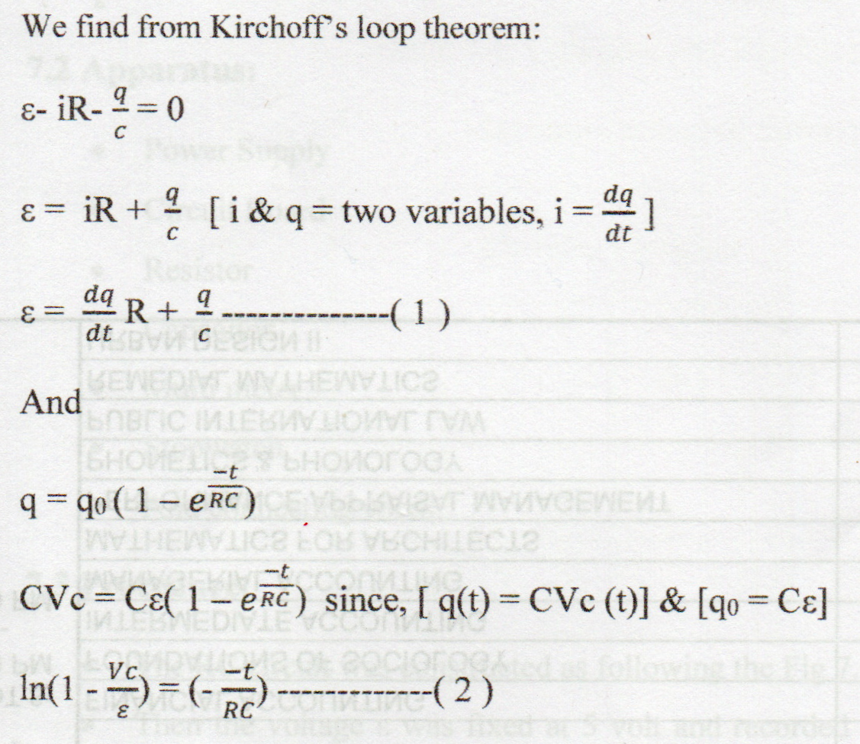
Theory
Charging a capacitor
At initial peak, the capacitance of the capacitor was zero.
As soon as, we closed the point A, the charge q start to flow between the capacitor.
The current flow becomes neutral when potential difference of the capacitor and emf ε are in equilibrium.
The fully charge can be expressed as q = Cε
A
+
-
R
B
C
V (t)
Figure: RC Circuit

Slide 6
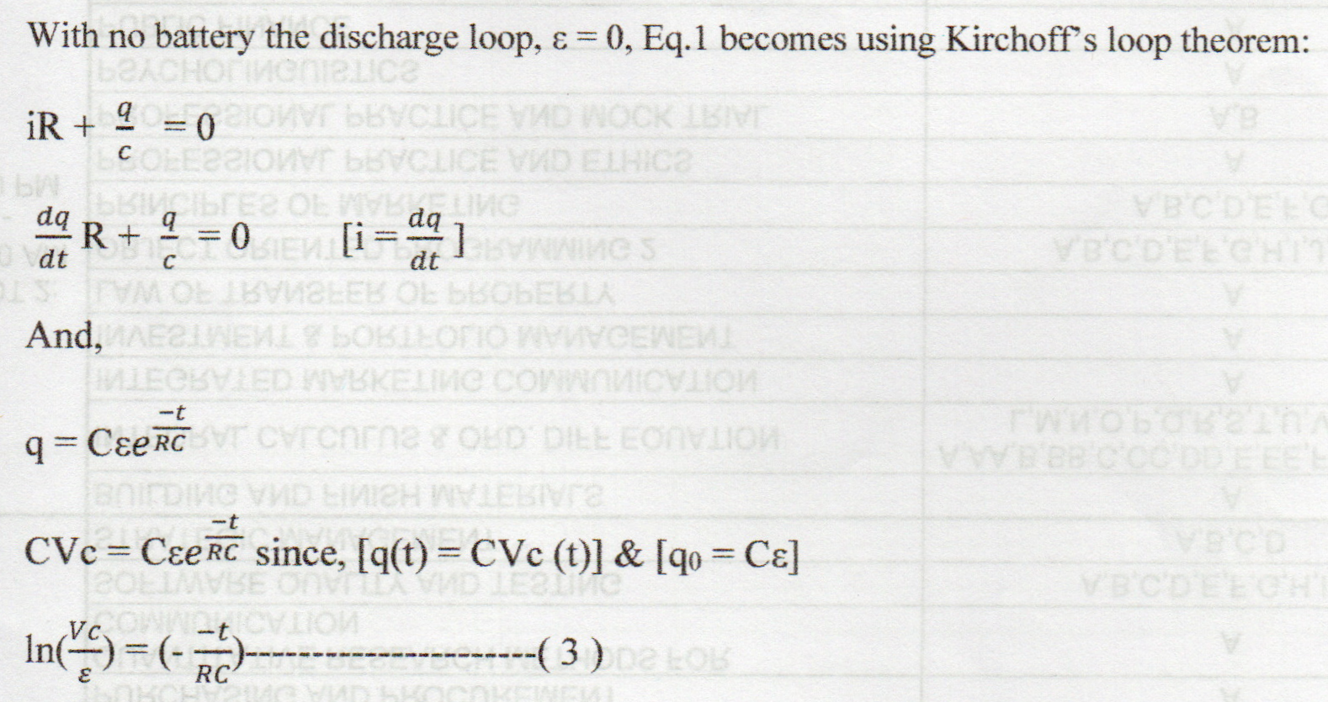
Theory
Discharging a capacitor
The final charge potential V₀ will be equal to the emf ε of the battery.
The point B will be closed instead of A so that the discharging process can begin.
The charge q(t) on the capacitor and the current i(t) through the discharge loop vary with time.
A
+
-
R
B
C
V (t)
Figure: RC Circuit

Slide 7
Apparatus
Power Supply
Circuit Board
Resistor
Capacitor
Multi meter
Stopwatch
And connecting wires

Slide 8
Procedure
The RC circuit was connected as following the figure diagram shows.
Then the voltage ε was fixed at 5 volt and recorded the charging Vc (volt) values from digital multimeter respect to time with the time interval of 30 sec. We took 15 measurements of Vc voltage from 0 sec to 420 sec.
The procedure for discharging process had been done same as the charging process but for this time the power supply was disconnected.
A
+
-
R
B
C
V (t)
Figure: RC Circuit

Slide 9
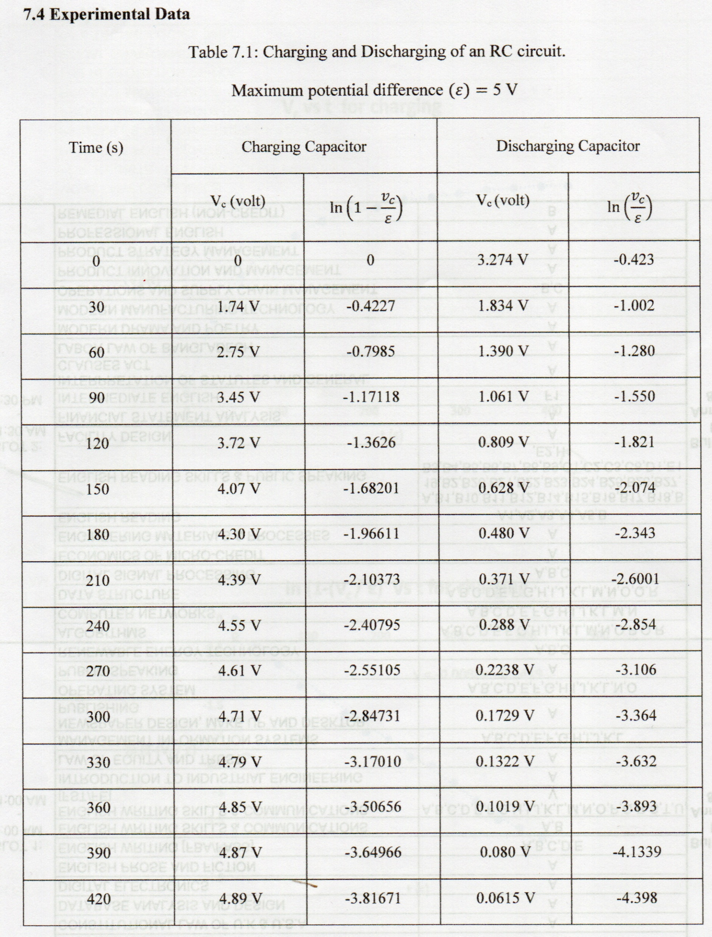
Experimental Data

Slide 10
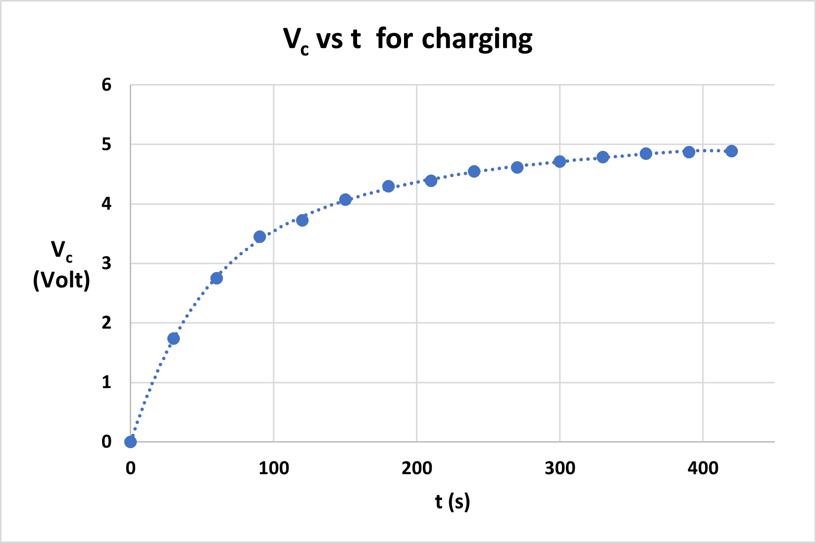
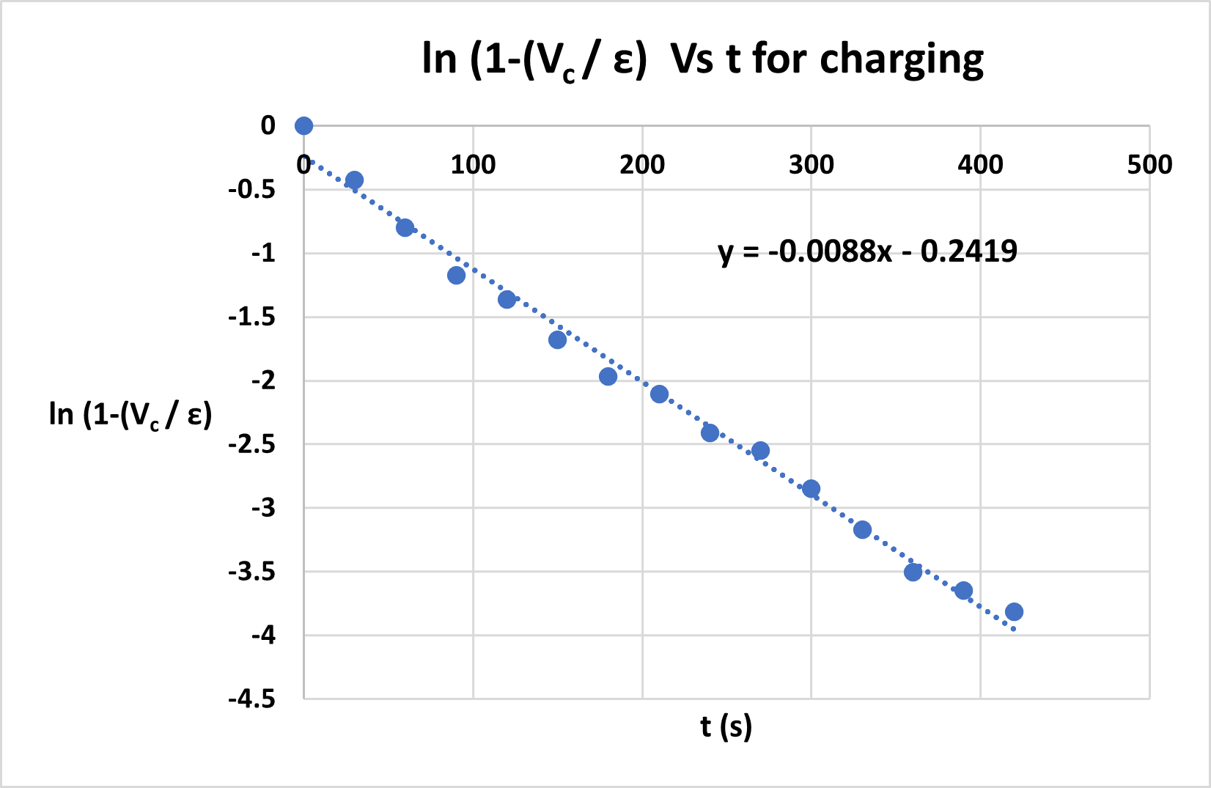
Analysis for Charging

Slide 11
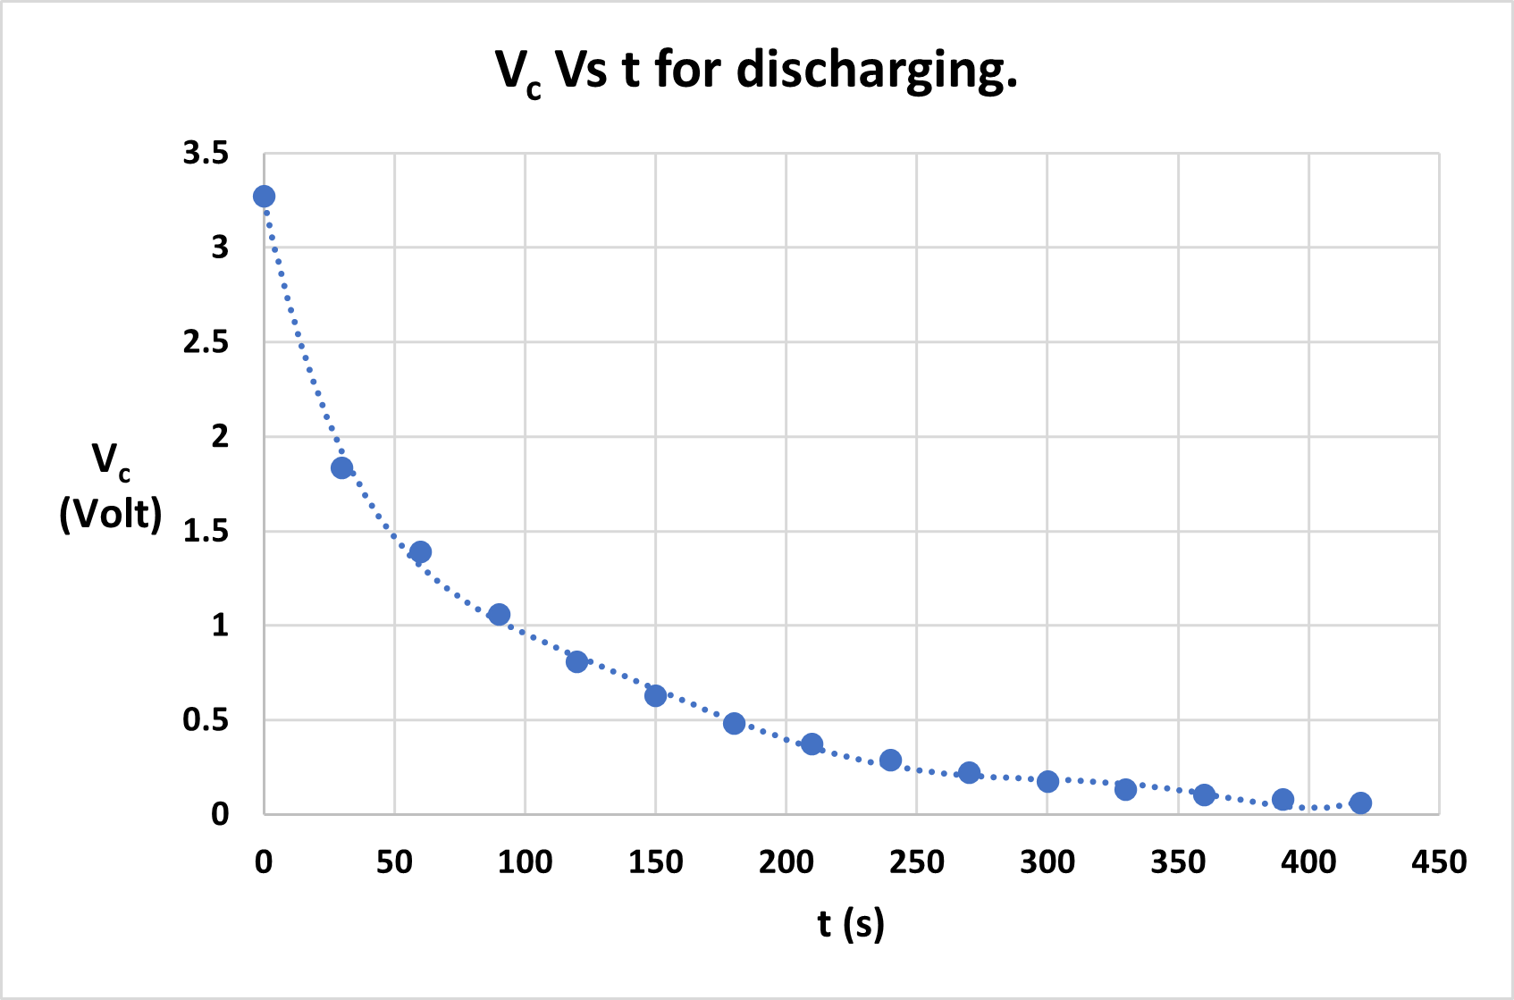
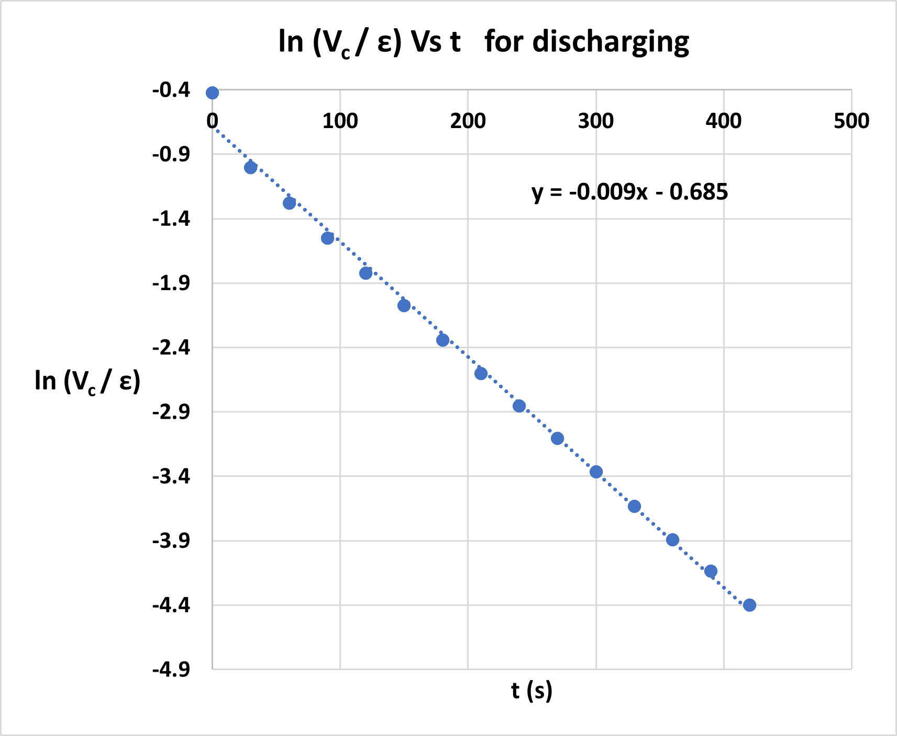
Analysis for Discharging

Slide 12
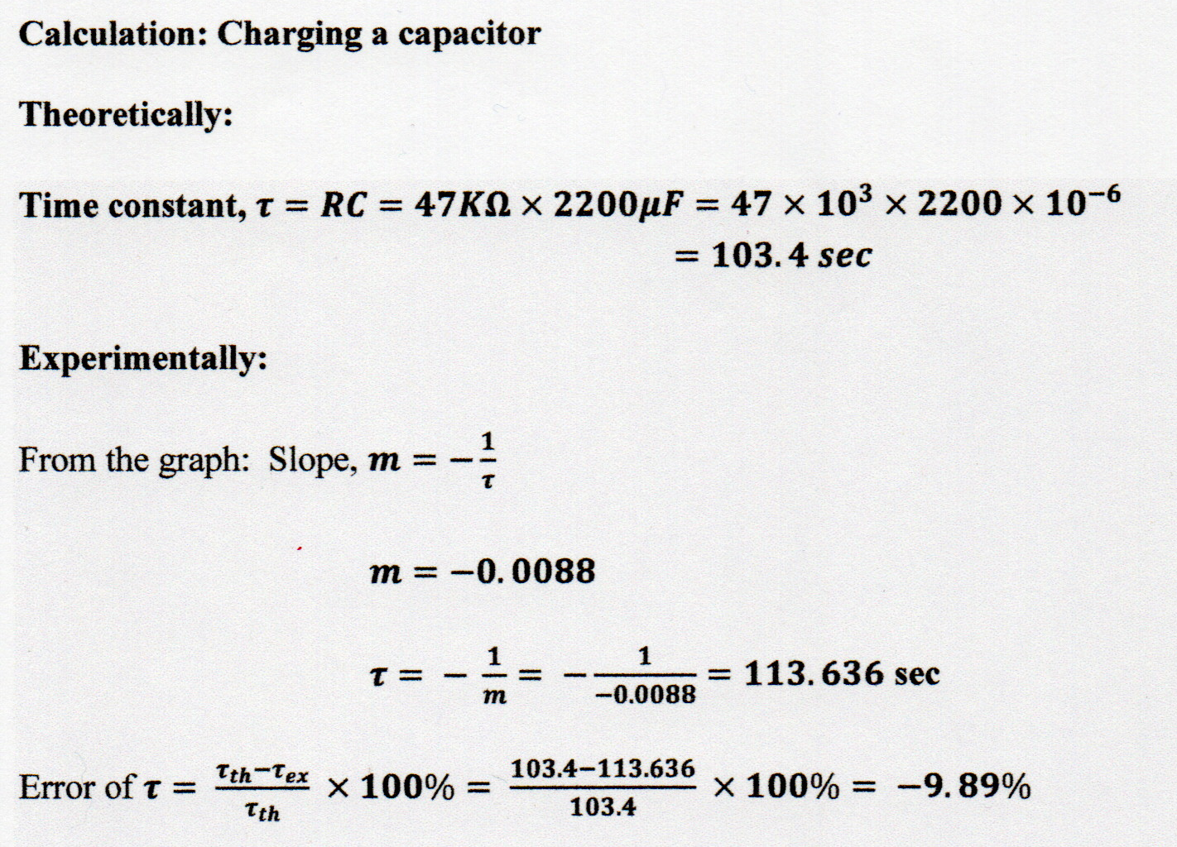
Calculations for Charging

Slide 13
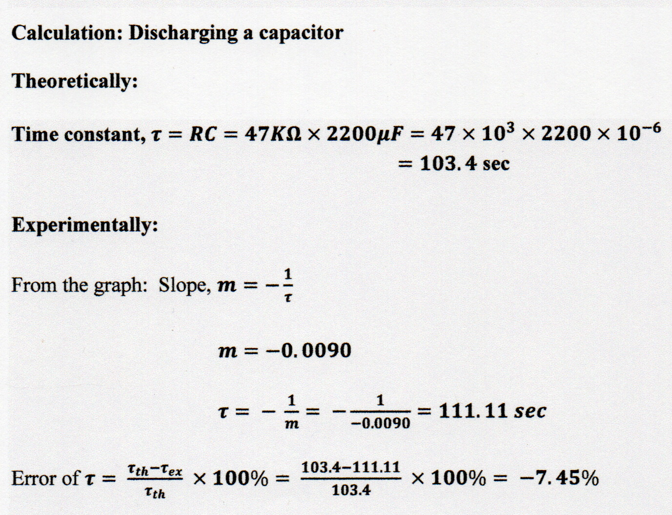
Calculations for Discharging

Slide 14
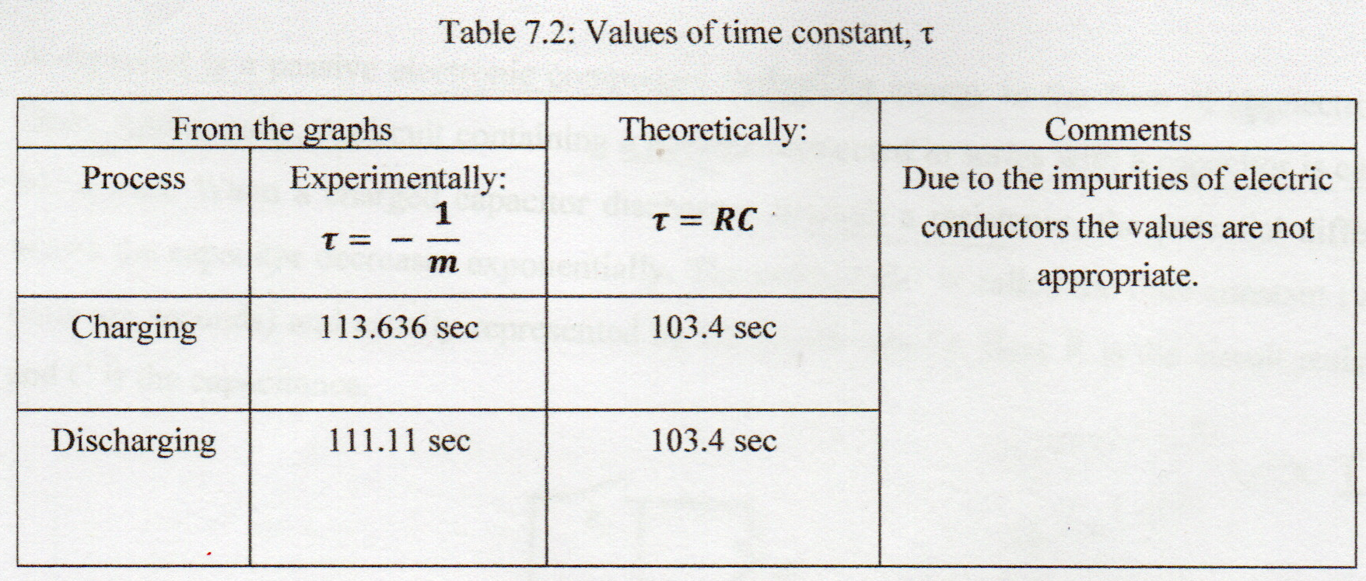
Results

Slide 15
Discussions
There might be some impurities present in the electrical components.
Improper installation of series circuit could have caused systematic errors.
Recordings of Vc (Volt) values from digital multimeter might have visual faults.
Some Error Values of Vc (Volt) might cause faults in final calculations.
Readings from stopwatch were taken sincerely and appropriately.
Proper precaution were taken during the setup and installation othe experimental apparatus.

Slide 16
References
https://www.phy.olemiss.edu/lab/englab/LabManual/Summer21/Worksheets%20and%20Procedures/RC/Lab%206/RC_time_procedure.pdf
https://en.wikipedia.org/wiki/RC_circuit
Physics Lab Manual.

Slide 17
Thank You

